Slide 1
Reverse Parking System
Computer Department
Engineering Informatics Project
Group Members
Mehul Patil (SCSB305)
Neha Patil (SCSB306)
Niranjan Patil (SCSB307)
Guided by :-
Mr .Pramod Ganjewar

Slide 2
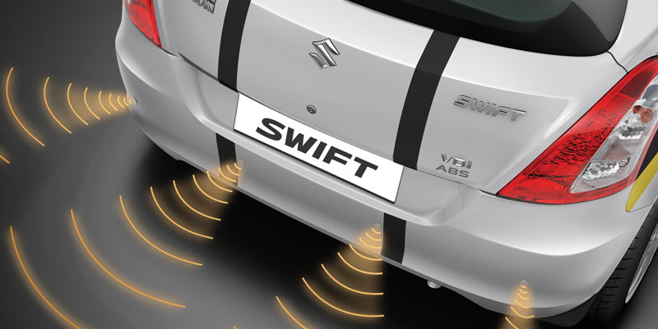
Problem Statement
Design reverse parking obstacle detection using Ultrasonic Sensor and LEDs.
To design raspberry pi system for sensing length of obstacles behind car.

Slide 3
Introduction of Raspberry pi
The Raspberry Pi is a credit-card-sized computer that plugs into a computer monitor or TV, and uses a keyboard and mouse. It is a capable little device that enables people of all ages to explore computing, and to learn how to program in languages like Scratch and Python.

Slide 4
Components of Raspberry pi
4 USB ports
10/100 Ethernet port
RCA video or Audio jack
CSI camera connector
HDMI video or audio connector
Micro USB connector (to power RPI)
Status LED
Micro SD card slot
DSI display connector
Chip antenna

Slide 5
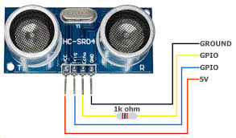
Sensors and it’s configurations
Ultrasonic sensor : HCSR04
Vcc-connect to +5V.
Trigger-a pulse is sent from here.
Echo-a pulse sends signal back by detecting object .
It has PIN configuration below…

Slide 6
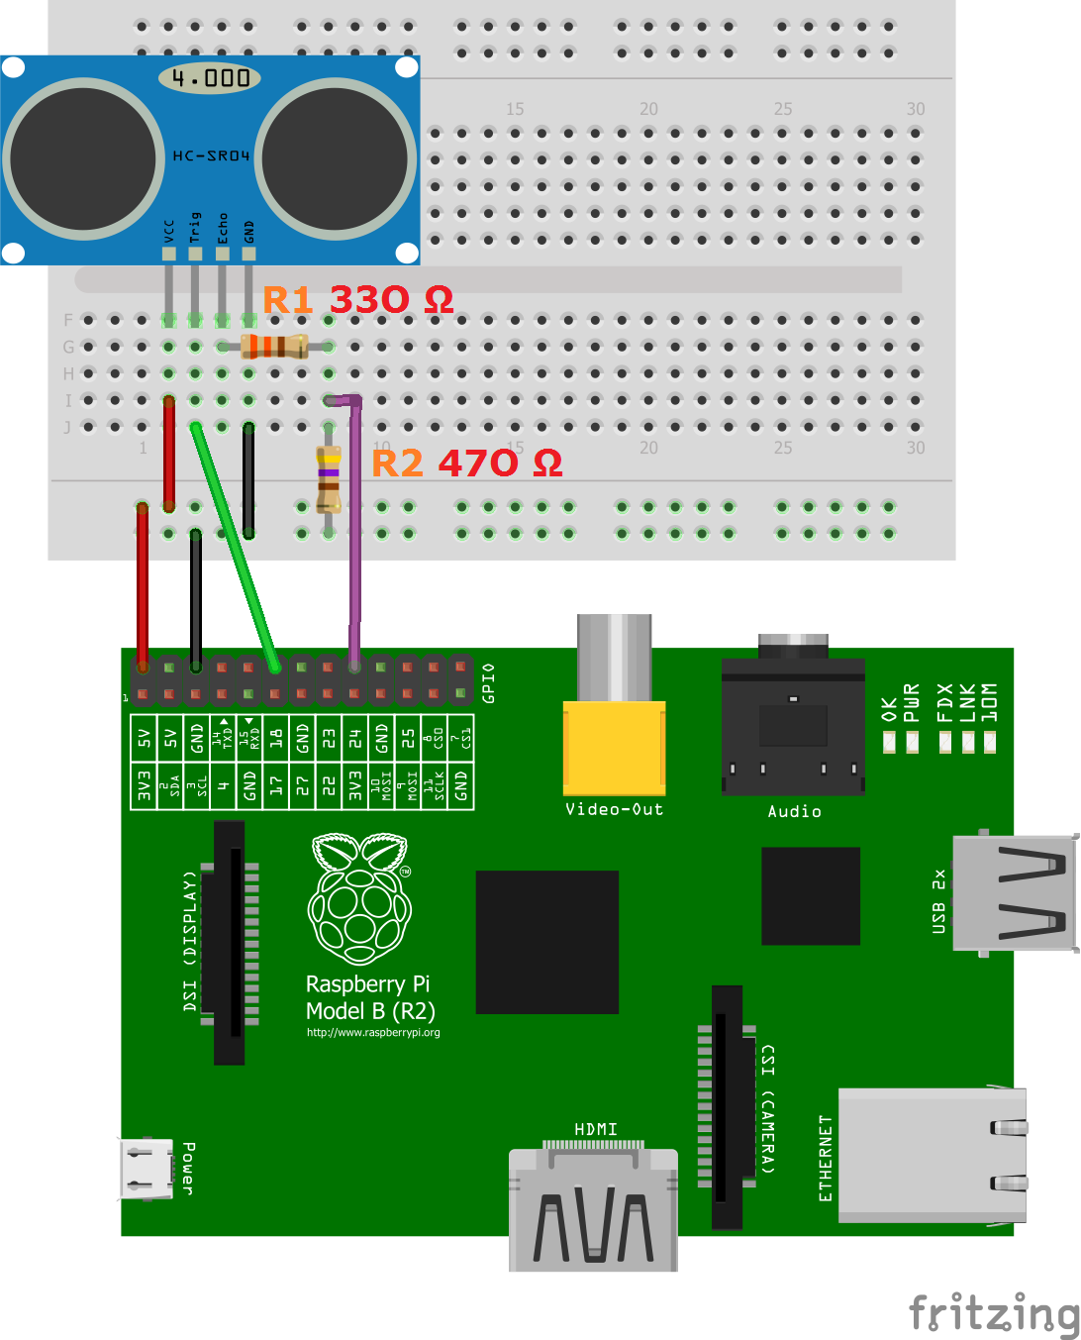
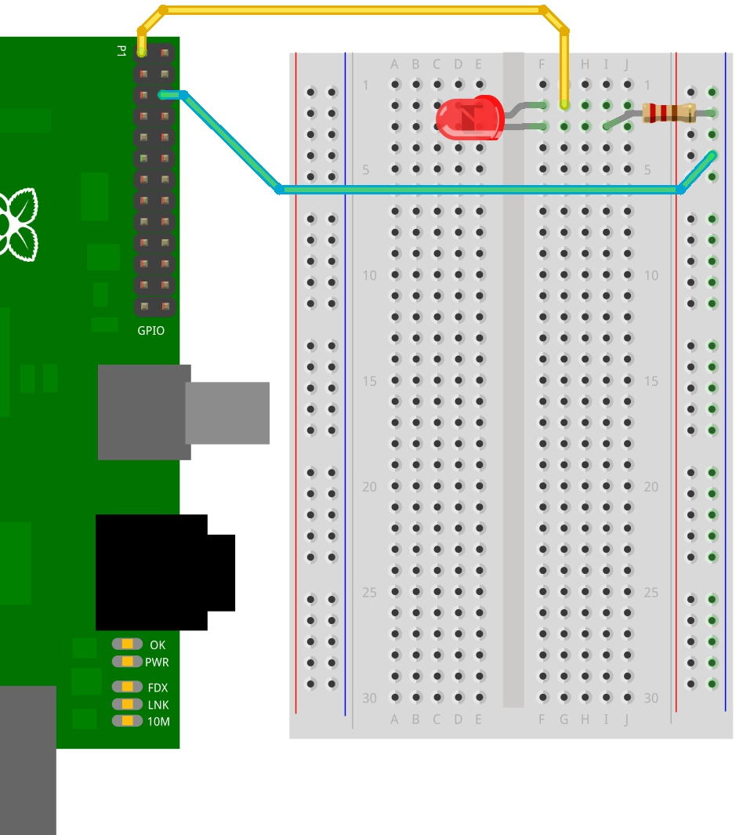
Circuit Diagram

Slide 7
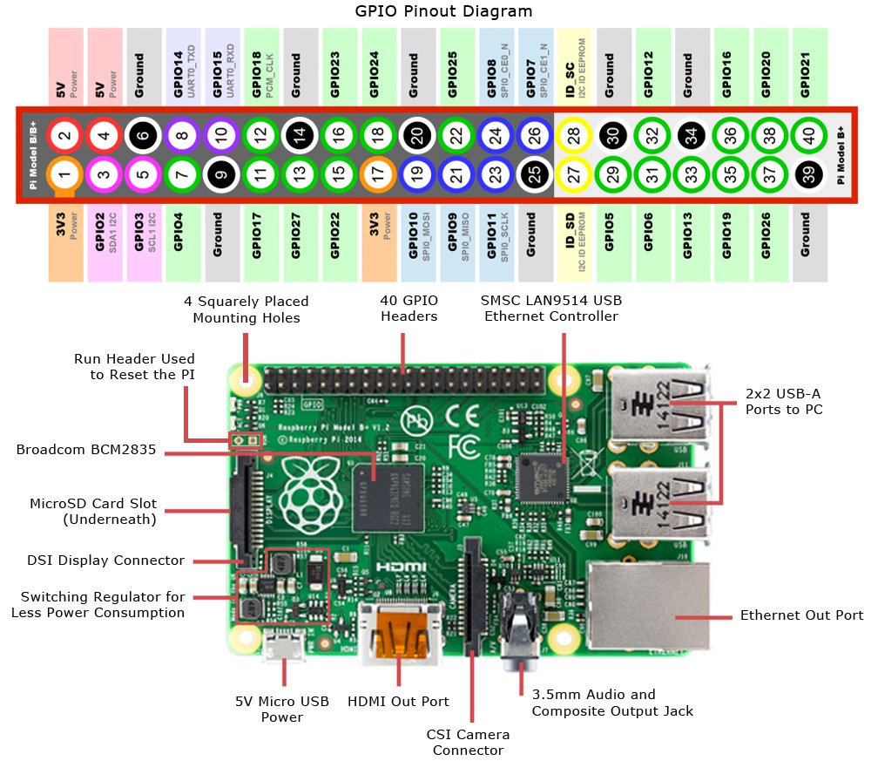
Pin configuration of Raspi

Slide 8
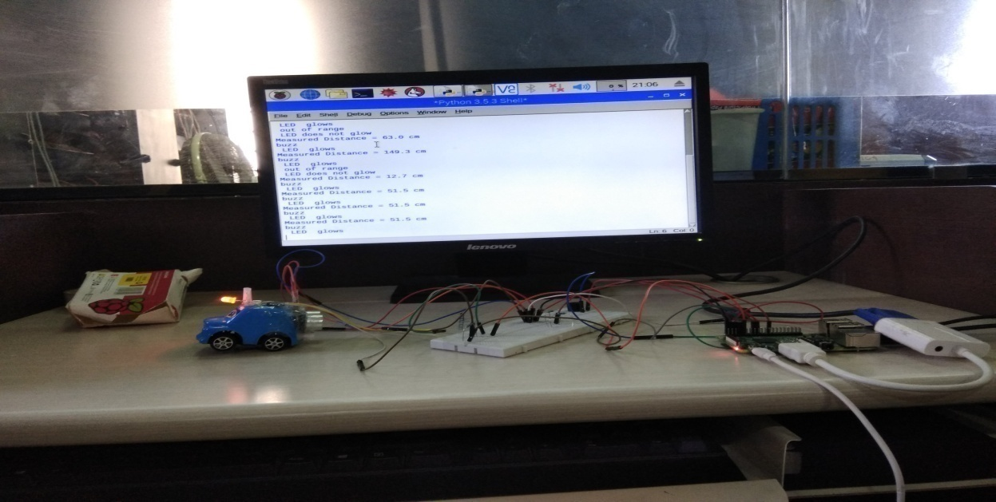
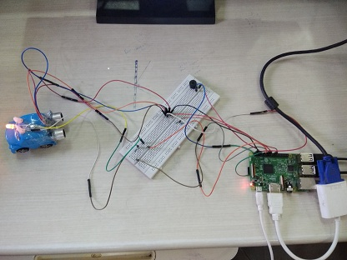
Project Pictures

Slide 9
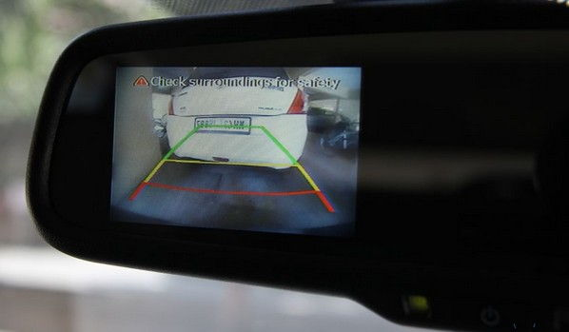
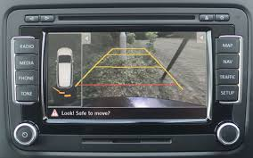
Future Scope
We can use camera with ultrasonic sensor to detect obstacles
Camera will use image processing technique to reverse parking
We can automatically stop car wheels when distance is too close to obstacle
That can be used in machine intelligence automatic car by GOOGLE.

Slide 10
Conclusion
We studied about the working of Raspberry Pi and also got knowledge of it’s components.
Also studied different types of sensors like ultrasonic sensor .We studied about their pin diagram and their interfacing with raspberry pi .

Slide 11
THANK YOU …

